Slide 1
HOSPITAL MANAGEMENT DASHBOARD
Healthcare Data Analysis & Operational Insights Presented by: Rahul Kalaskar

Slide 2
Project Introduction
Hospital management involves handling large amounts of patient and operational data.
Manual analysis of this data can be time-consuming.
This project converts raw hospital data into an interactive Excel dashboard.
The dashboard helps analyze patients, doctors, departments, diseases, payments and waiting time.
Users can interact with the dashboard using Slicers.

Slide 3
Project Objectives
🎯 Analyze Patient Data
Understand patient demographics, categories and visit patterns.
🏥 Analyze Department Performance
Identify departments with high transaction volumes.
💰 Analyze Revenue & Payments
Understand revenue and different payment methods.
⏱️ Monitor Patient Experience
Analyze patient rating and waiting time.
📊 Create Interactive Dashboard
Allow users to filter and explore data dynamically.

Slide 4
DATASET OVERVIEW
Metric | Value
Total Patients | 40,000
Total Doctors | 80
Total Revenue | ₹61,97,61,405
Average Patient Rating | 4.0 / 5
Average Waiting Time | 33.7 minutes
Major Data Categories
Patient Information
Doctor Information
Department
Patient Status
Disease
Payment Method
Insurance
Visit Type
Patient Type

Slide 5
Tools & Technologies
🟢 Microsoft Excel
Data Cleaning
Removed duplicates
Checked missing values
Standardized data
Data Analysis
PivotTables
Calculations
Aggregations
Data Visualization
PivotCharts
KPI Cards
Slicers
Dashboard
Interactive filters
Professional formatting
Dynamic KPIs and charts

Slide 6
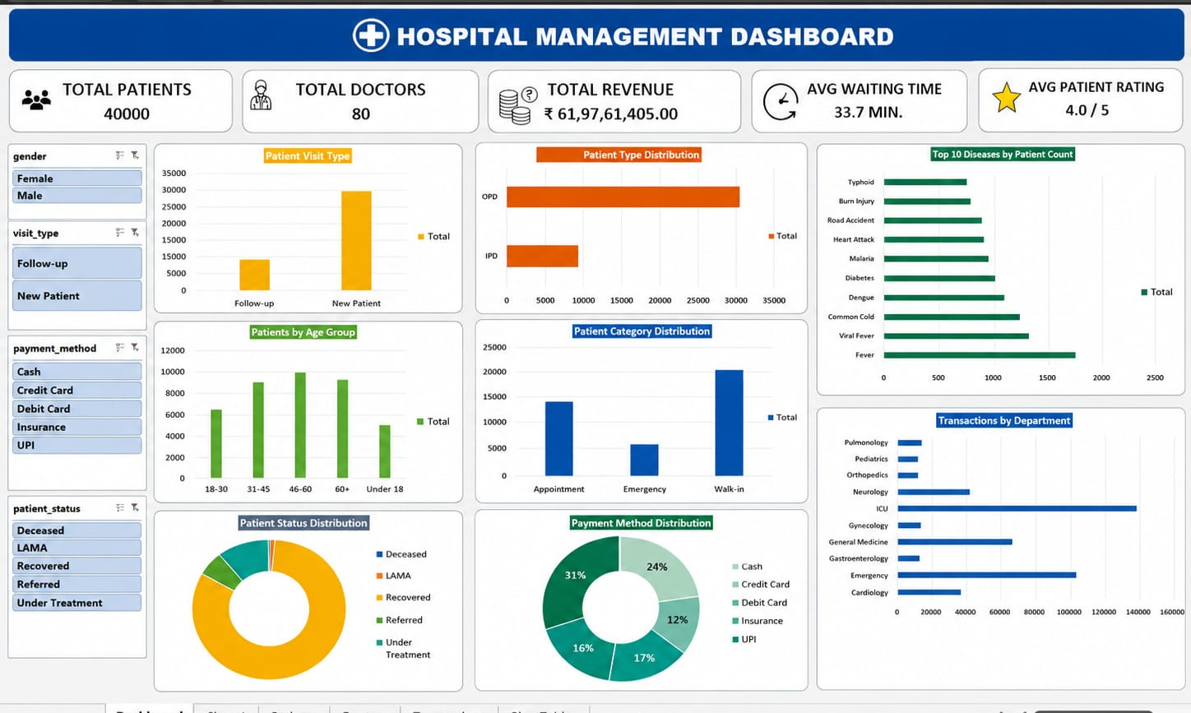
Dashboard Overview

Slide 7
BUSINESS INSIGHTS
KEY BUSINESS INSIGHTS
🏥 Department Performance
ICU has the highest transaction volume.
👥 Patient Category
Walk-in patients form the largest patient category.
📊 Age Segment
The 46–60 age group represents one of the largest segments.
⭐ Patient Satisfaction
Average patient rating is 4.0/5.
⏱️ Patient Flow
Average OPD waiting time is 33.7 minutes.
🦠 Disease Trends
Fever and other common conditions contribute significantly to patient volume.

Slide 8
RECOMMENDATIONS
01 — Improve Patient Flow
Analyze peak OPD periods to reduce waiting time.
02 — Optimize Resources
Allocate doctors and resources according to department demand.
03 — Monitor High-Volume Diseases
Track frequently occurring diseases for better planning.
04 — Focus on Major Patient Segments
Develop services based on high-volume age groups and patient categories.
05 — Monitor Patient Satisfaction
Continue tracking ratings to maintain service quality.

Slide 9
CONCLUSION
"The Hospital Management Dashboard transforms raw healthcare data into meaningful and interactive insights.“
Key Benefits
✅ Faster analysis
✅ Interactive filtering
✅ Easy performance monitoring
✅ Better understanding of patient trends
✅ Supports data-driven decision-making

Slide 10
THANK YOU

